Slide 1
Foreign Direct Investment Analytics
BY:- ABHI SAHU

Slide 2
Problem Statement
To understand the Foreign direct investment in India for the last 17 years from 2000-01 to 2016-17.
Find key metrics and factors and show the meaningful relationships between attributes.

Slide 3
Details of Data
This dataset contains Sector’s and Financial year-wise data of FDI in India.

Slide 4
Main KPIs
Yearly FDI Trend
Sector-wise FDI Distribution
Top FDI Sector’s
Lowest FDI Sector’s
Tools Used for Analysis are – Tableau
Tableau Public Link:- https://public.tableau.com/views/ForeignDirectInvestmentdashboard/Dashboard1?:language=en-US&:sid=&:display_count=n&:origin=viz_share_link

Slide 5
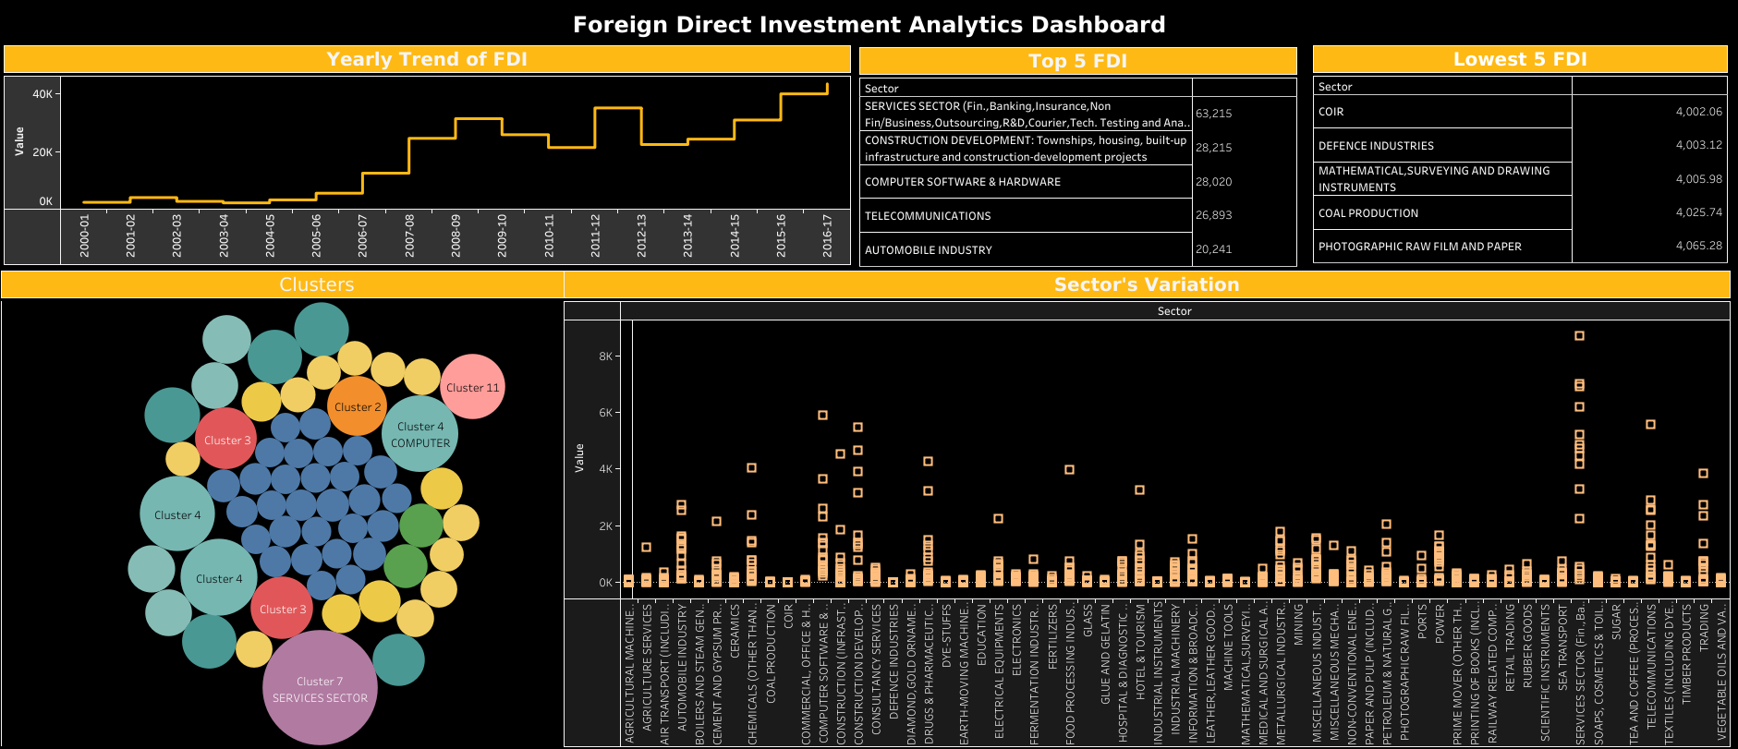
My Design

Slide 6
Thank You

